Slide 1
Email Information Extraction
Documentation

Slide 2
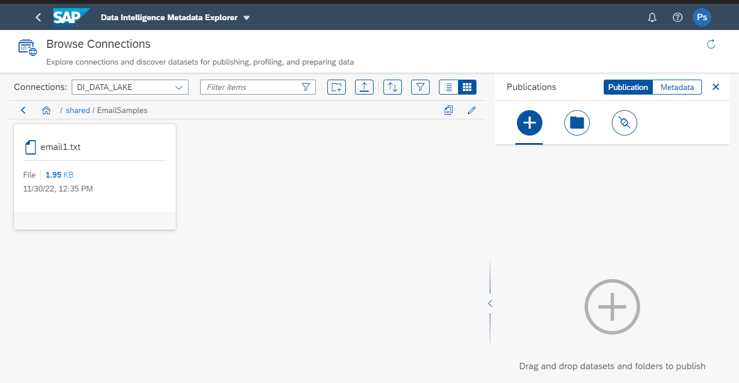
Data Source Location

Slide 3
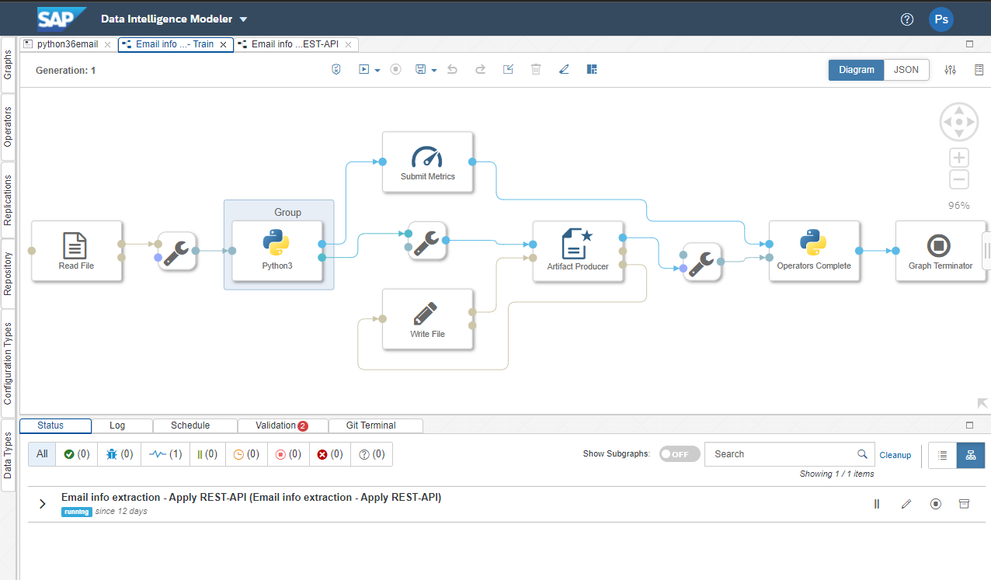
Model creation Pipeline

Slide 4
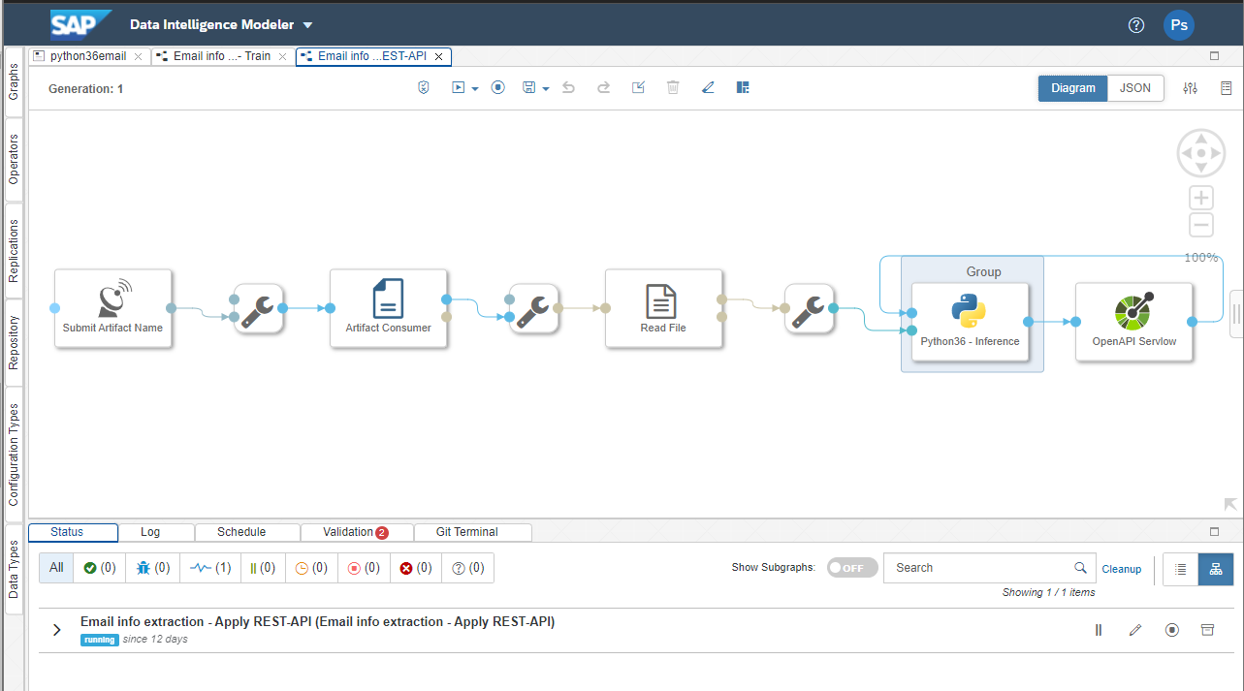
Inference API Pipeline in SAP DI

Slide 5
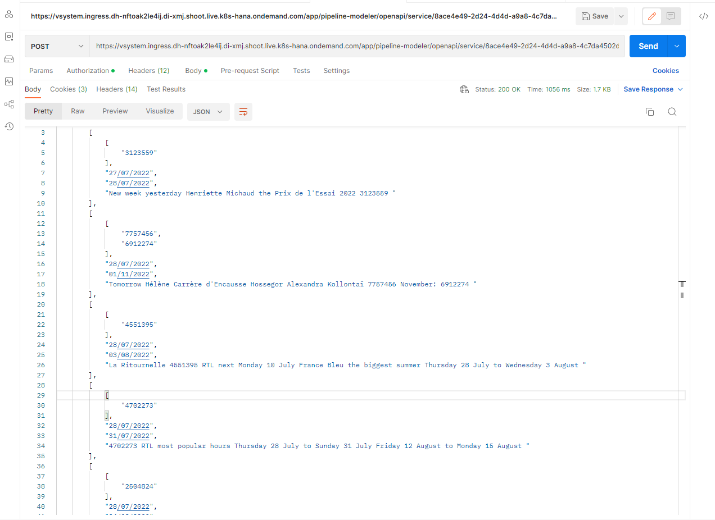
API request in Postman
In response it returns:
Product ID
Start Date
End Date
Description

